Slide 1
Research Project
Meiru Zhong

Slide 2
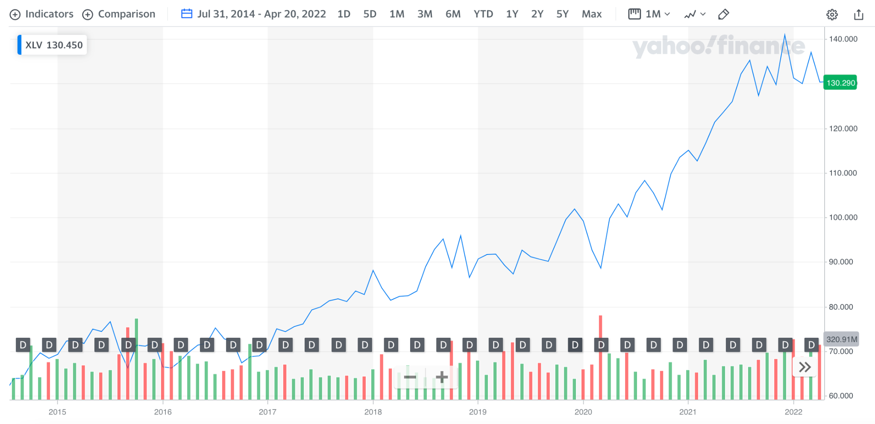
Introduction
Stock Index:
XLV Health Care Select Sector SPDR Fund
Composed of 62 stocks
Data Time Range :
Historical daily data from 2014 - 2022
XLV Price Trend

Slide 3
Part 1: ETF TE
Minimize tracking error for XLV ETF

Slide 4
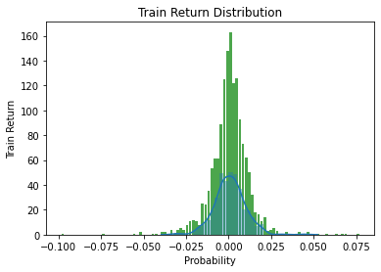
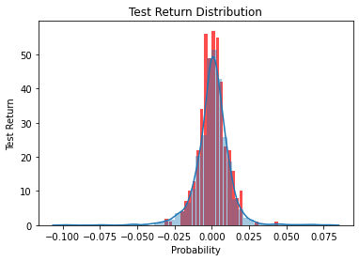
Split Data
Training period: 2014/07/31 - 2020/07/30
Testing period: 2020/07/31 - 2022/04/19

Slide 5
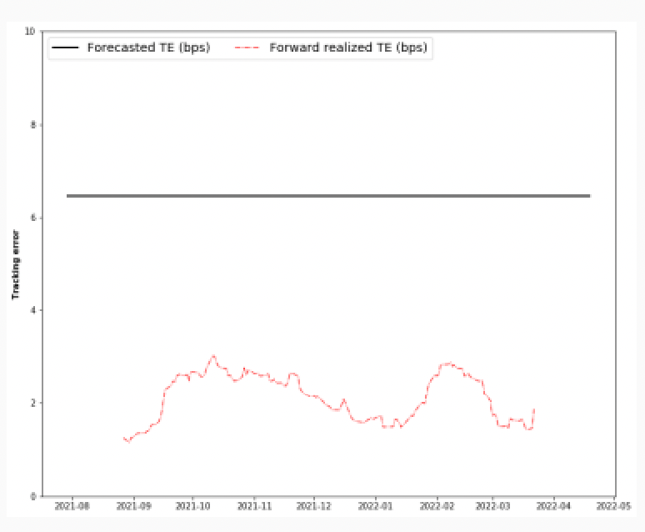
Minimize TE Strategy
Tracking Error Comparison
Conditional method with two regimes:
Risk-on (good for equity)
Risk-off (bad for equity)
Full-replication for training:
EWMA Daily TE = 1.44 bps
Risk-on Daily TE = 1.56 bps
Full-replication for testing:
Realized Daily TE = 1.25 bps

Slide 6
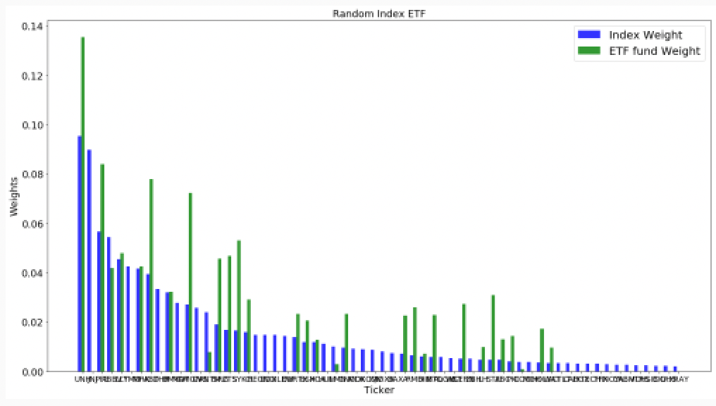
Optimized Weights:
Random 35 stocks selected
Random 35 weighted stocks replication daily EWMA TE = 5.60 bps

Slide 7
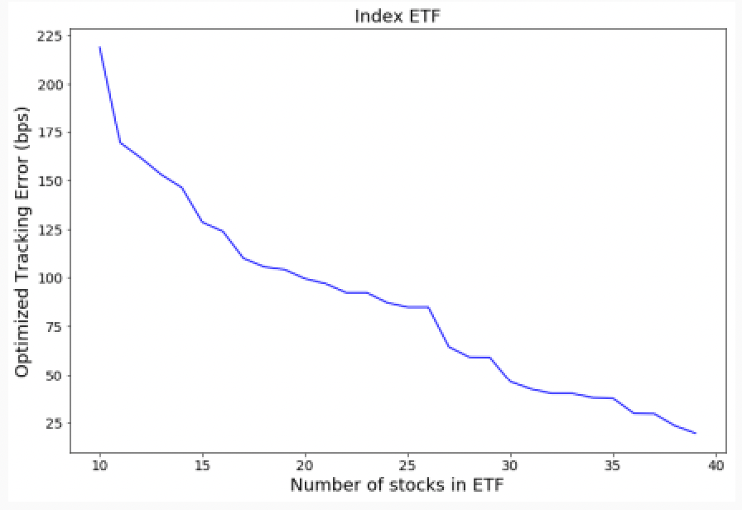
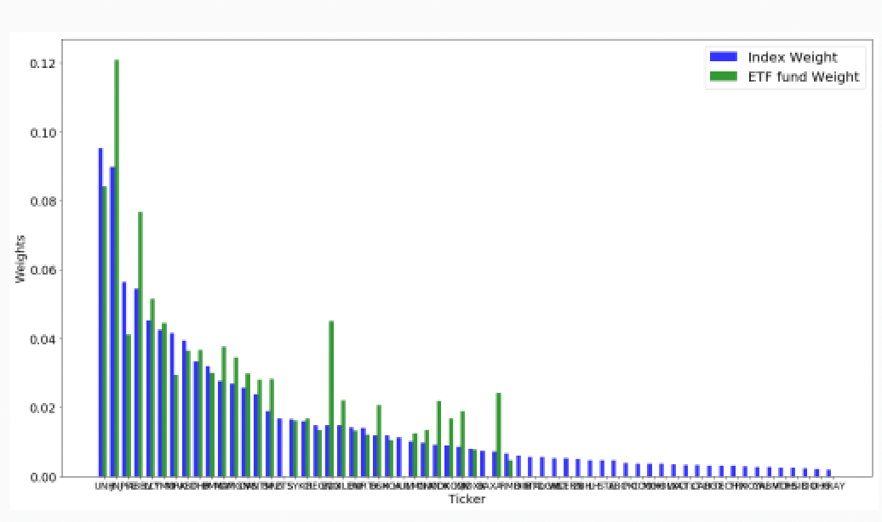
Optimized Weights:
Optimized Weights vs. #40 of stocks
Top 35 stocks selected
Top 35 weighted stocks replication daily EWMA TE = 2.36 bps

Slide 8
Part 2: Risk Parity
Find the best portfolio

Slide 9
Assets Group
Ten assets: 2 equity ETF, 7 bond ETF, 1 GLD trust
XLV : Health Care Select Sector SPDR Fund
XLC: Communication Services Select Sector SPDR Fund
TLT : iShares 20 Plus Year Treasury Bond ETF
VCIT : Vanguard Intermediate-Term Corp Bond
LQD: iShares iBoxx $ Inv Grade Corporate Bond ETF
SPSB: SPDR Portfolio Short Term Corporate Bond ETF
SHY : iShares 1-3 Year Treasury Bond ETF
JNK: SPDR Bloomberg High Yield Bond ETF
BNDX: Vanguard Total International Bond Index Fund ETF
GLD : SPDR Gold Trust
Rank
5.6/10
3.4/10
5.8/10
8.4/10
8.4/10
9.4/10
5.8/10
4.9/10
6.6/10
Equity
Bonds
Trust

Slide 10
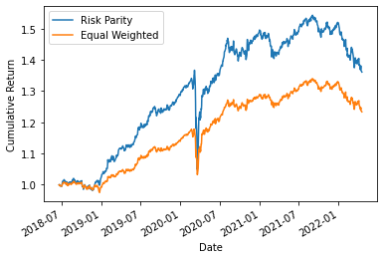
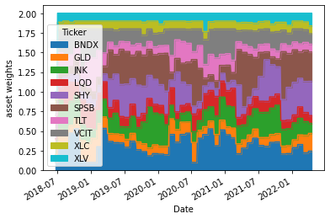
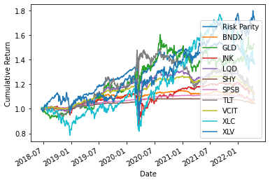
Portfolio 1
With ewma
With leverage
Sharpe ratio of different strategies:
risk_parity 0.86
equal_wted 0.68
Sharpe ratio of different strategies:
risk_parity 0.86
XLV 0.77
TLT 0.11
GLD 0.79
VCIT 0.43
XLC 0.36
LQD 0.29
SPSB 0.43
SHY 0.99
JNK 0.32
BNDX 0.32

Slide 11
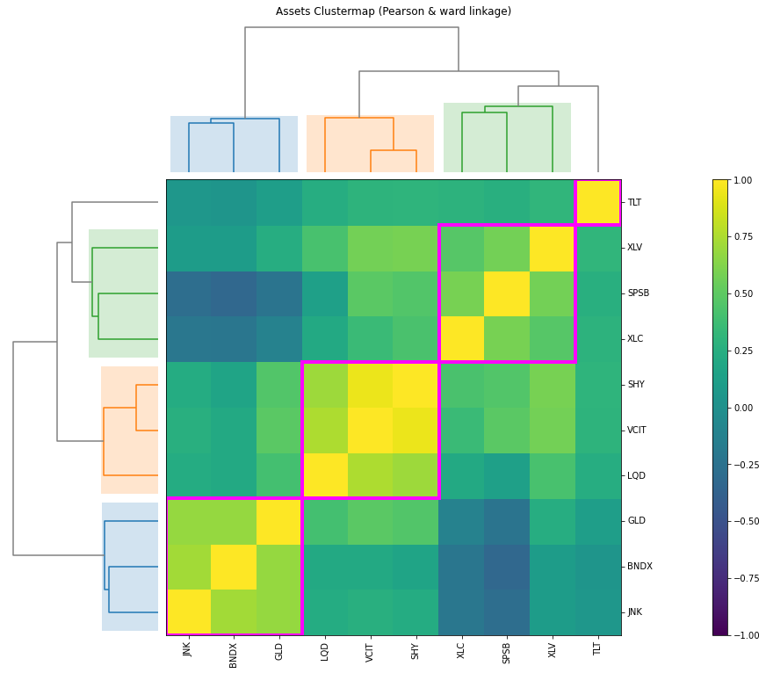
Hierarchical
Risk-Parity
Group 1 TLT
Group 2 XLV, XLC,SPSB
Group 3 SHY, VCIT, LQD
Group 4 GLD, JNK, BNDX

Slide 12
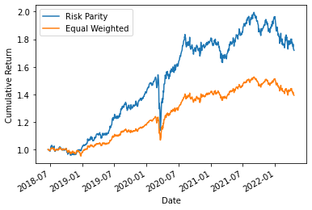
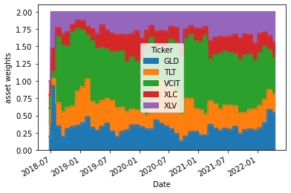
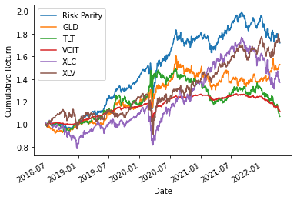
Portfolio 2
Sharpe ratio of different strategies:
risk_parity 1.01
equal_wted 0.96
Sharpe ratio of different strategies:
risk_parity 1.01
XLV 0.77
TLT 0.11
GLD 0.79
VCIT 0.43
XLC 0.36

Slide 13
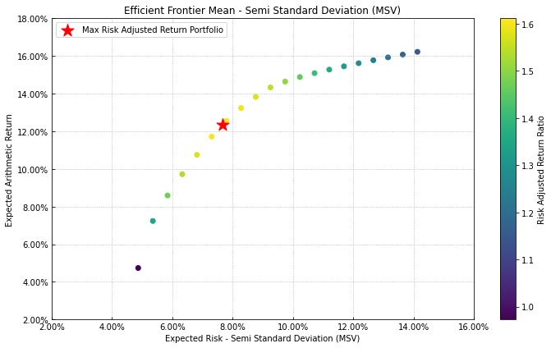
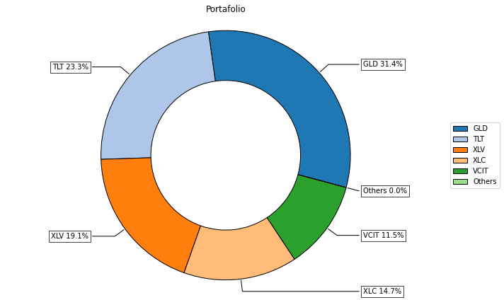
Best Portfolio
Rolling time window = 90 days
Monthly rebalancing
With leverage: sum(W) = 1 or sum(W) = 2
Sharpe ratio =1.01
['XLV', 'TLT','GLD','VCIT','XLC']
35% bond 35% equity
30% trust

Slide 14
THANK YOU!
Any questions?

